Slide 1
What is LangChain?

Slide 2
Data Aware
Agentic

Slide 3

01
Value Proposition

Slide 4
Components
Use-Case Specific Chains

Slide 5
02
Components

Slide 6
Different components
01
02
03
04
05
06
Schema
Models
Prompts
Indexes
Chains
Agents

Slide 7
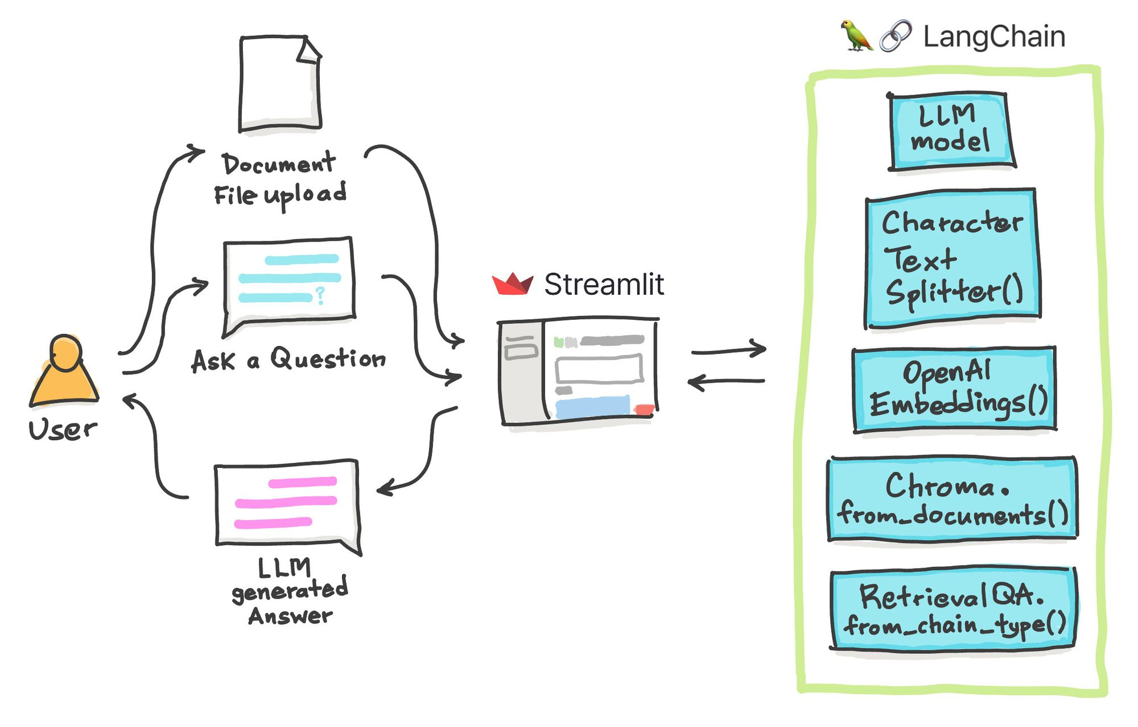
Schema
ChatMessages Schema
SystemChatMessages
HumanChatMessages
AIChatMessages: .

Slide 8
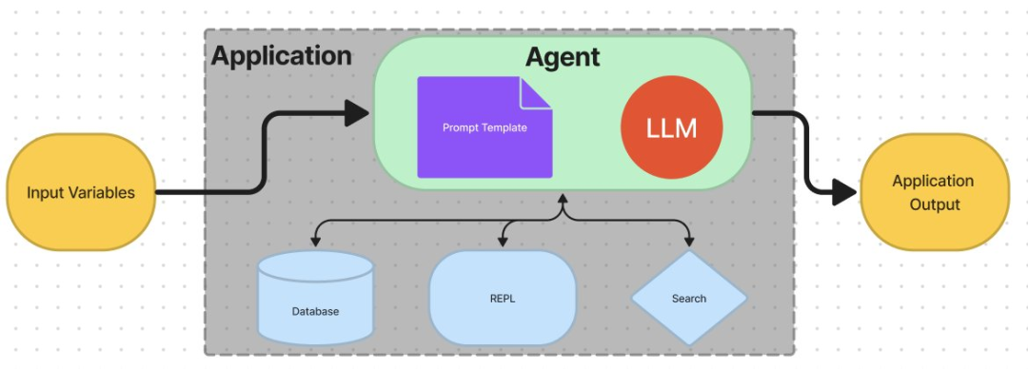
Models
a)LLMs
b)Chat Models
c) Text Embedding models

Slide 9
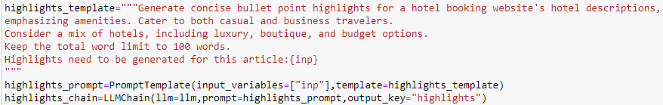
Prompts
Prompt Value
Prompt Templates
Example Selectors
Output Parsers

Slide 10
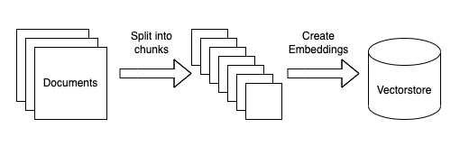
Indexes
Document Loaders
Text Splitters
VectorStores
Retrievers

Slide 11
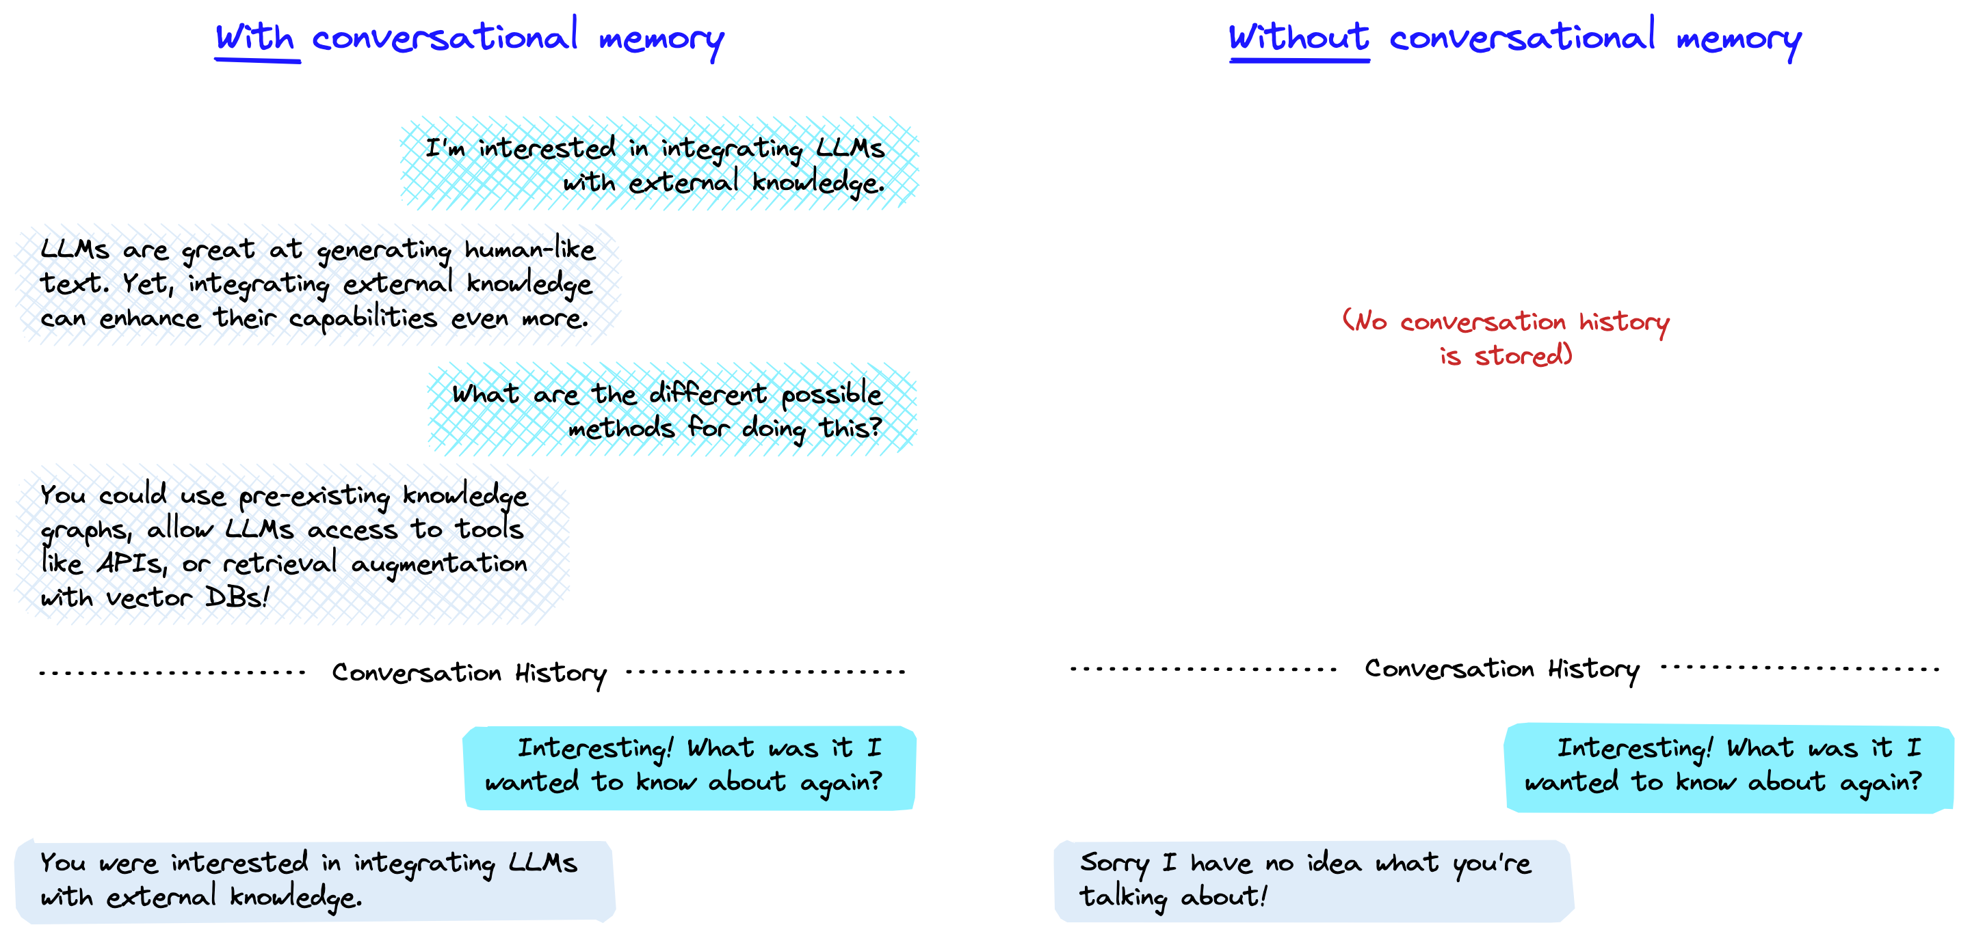
Memory
a)Short term memory
b)Long term memory

Slide 12
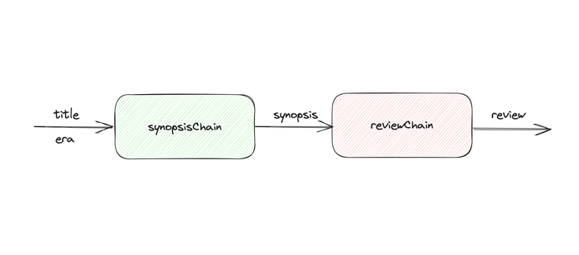
Chains

Slide 13
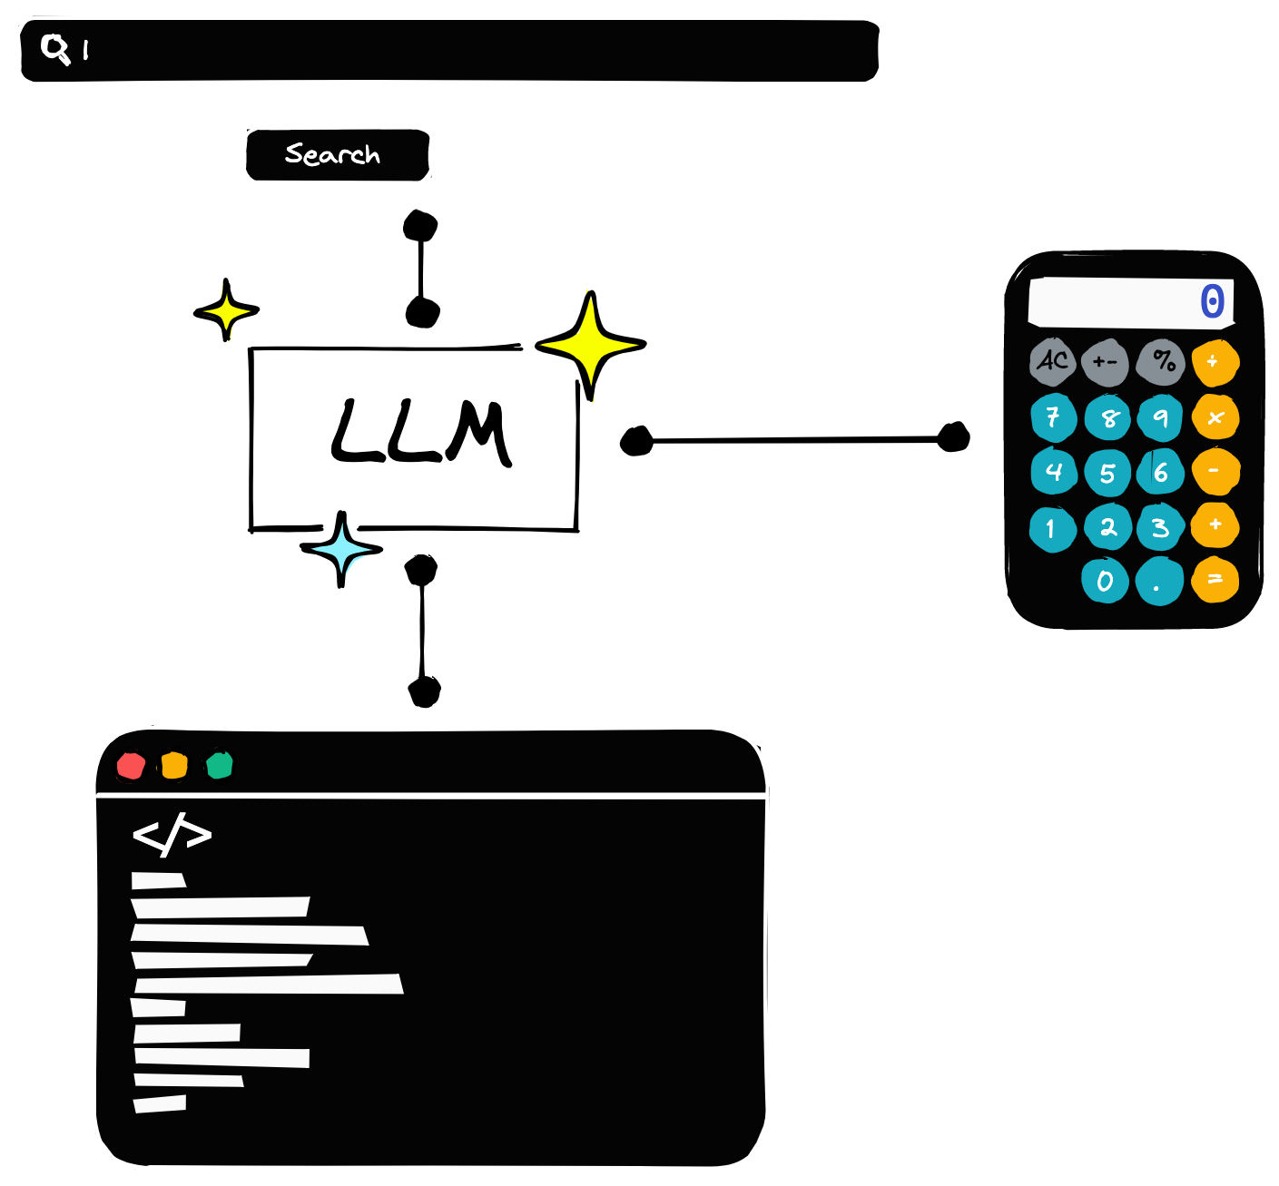
Agents
Tools
Agents
Toolkits
Agent Executor

Slide 14
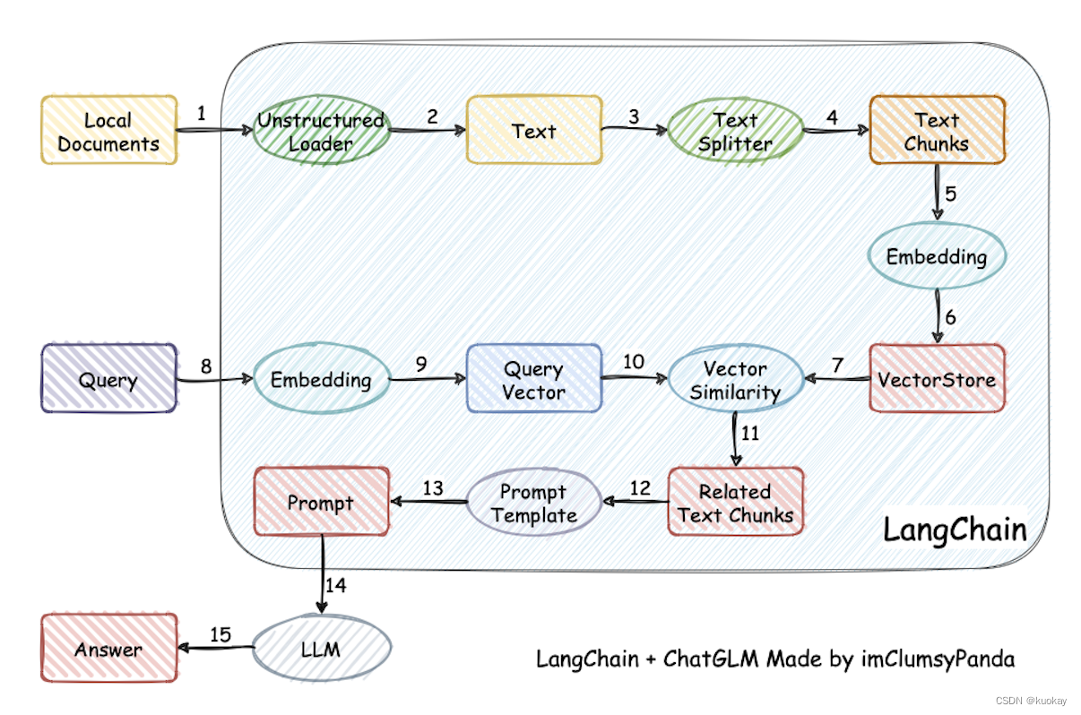
Sample Usecase- QNA Chatbot

Slide 15


